Slide 1
SAP HANA Live

Slide 2
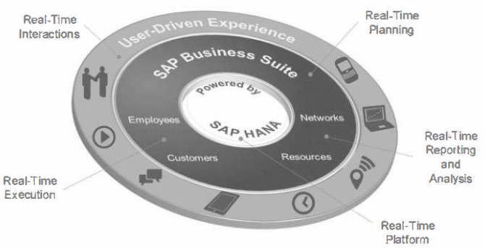
SAP Business Suite powered by SAP HANA
The SAP Business Suite is now powered by SAP HANA, the next generation platform. With SAP HANA, we can unify analytics and transactions into a single in-memory platform.
The suite now allows real-time planning, execution, reporting and analysis across your end-to-end business processes.

Slide 3
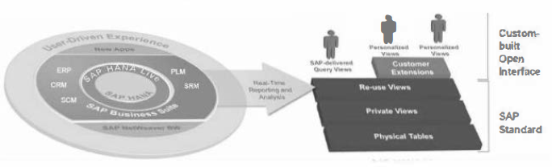
SAP HANA Live
SAP HANA Live is a comprehensive SAP HANA Virtual Data Model (VDM) to expose real-time Suite application data
Also provides Tools to explore and manage the VDM
SAP HANA Live consumes the highly normalized tables from Suite applications and presents them in a business meaningful way adding semantics.
A solution developed, supported and "certified" by SAP
There is a separate RDS for SAP HANA Live but we must not confuse SAP HANA Live with the RDS for SAP HANA Live
SAP HANA Live provides models and model exploration tools, SAP HANA Live RDS provides SAP BI reporting content based on SAP HANA Live models
SAP HANA Live delivers packages covering a large number of Suite application and specific solution areas (Fl, SD, MM, GRC, CRM etc.)

Slide 4
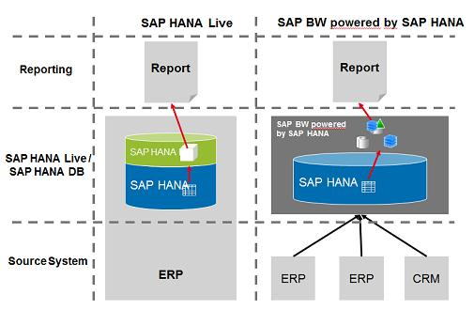
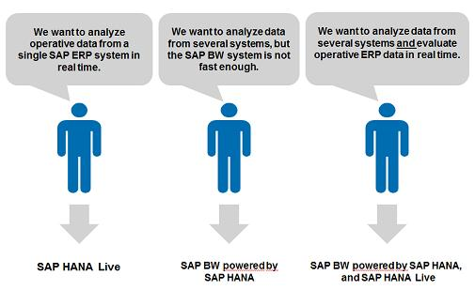

Slide 5
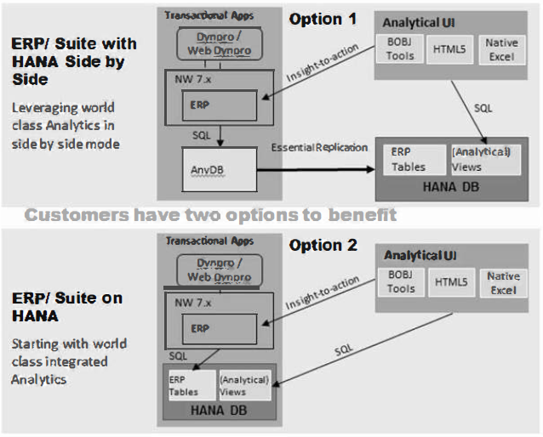
Deployment Options for SAP HANA Live

Slide 6
Installation
SAP HANA Live is an additional installation on top of SAP HANA
Latest SAP HANA Live installation files available from Service Marketplace
Use Solution Manager to manage installation
VDM is the heart of HANA Live (the models). But you need to choose which VDM you want (ERP, CRM, GRC etc.)
Additional tools are:
Analysis Authorization Assistant (AAA) Version 1 SP3
Live Explorer Version I SP6
Extend View Assistant (new tool) Version I SPO

Slide 7
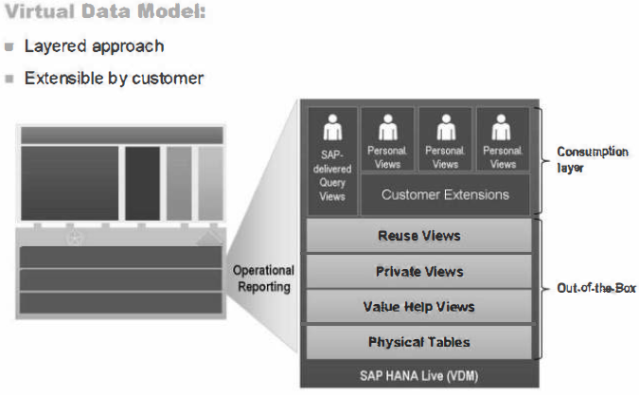
Architecture

Slide 8
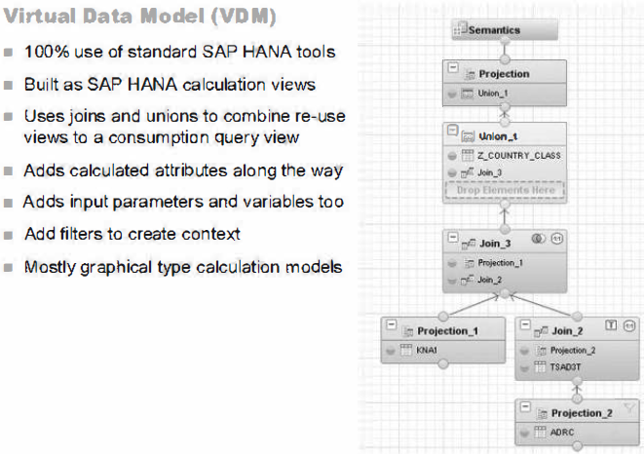

Slide 9
The virtual data model consists of the following four types of views:
Query views are designed for direct consumption by an analytical application (for example based on HTML5) or a generic analytical tool (for example BO tools). They are always the top view in a hierarchy of views and are not designed for reuse in other views.
Reuse views are the heart of the virtual data model. They expose the business data in a well-structured, consistent, comprehensible way covering all relevant business data in SAP Business Suite systems. They are designed for reuse by other views and must not be consumed directly by analytic tools.
Private views encapsulate certain SQL transformations on one or several database tables or even other views. They are not classified as reuse views as they might not carry clear business semantics but are rather intended to be reused in other views. They are comparable to subroutines or (private) methods in programming languages.
Value Help views provide a full list of possible values for major business entities (material, customers). These are used to populate drop down selection lists in the business application or report. Note: Value Help views are not consumed by VDM models but can be consumed by applications directly.

Slide 10
THANK YOU

